Slide 1
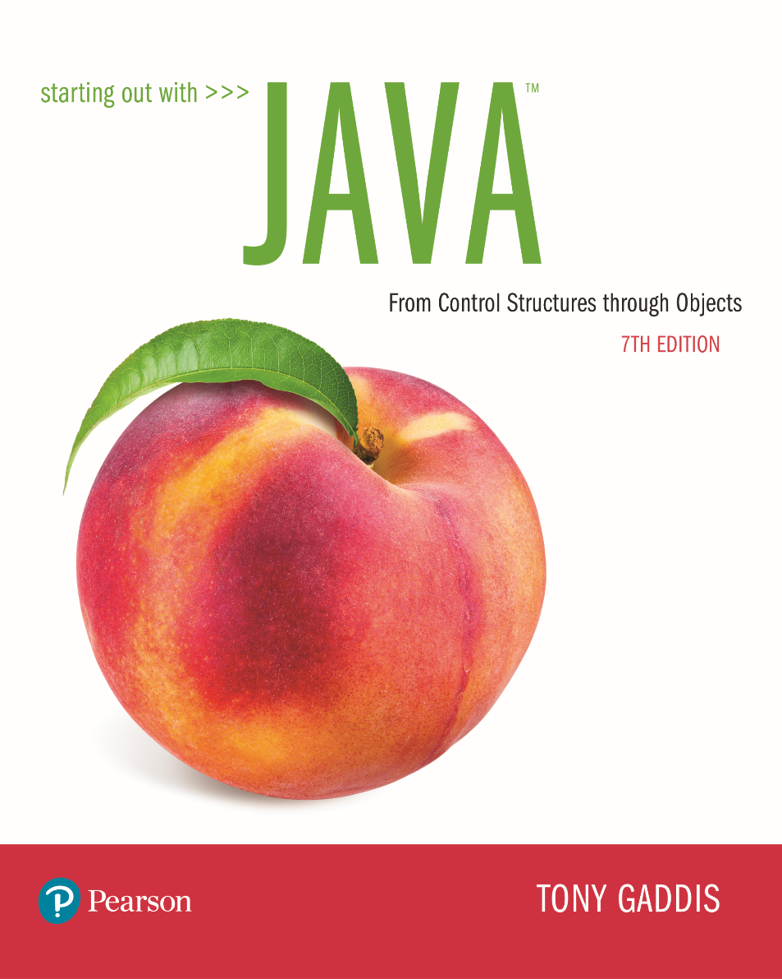

Slide 2
Examples’ Source Code
Source Code for examples presented in these slides can be found on:
Blackboard->Course Content->Source Code Of The Book Examples

Slide 3
Module 14 Topics
8.1 Static Class Members
8.2 Passing Objects as Arguments to Methods
8.3 Returning Objects from Methods
8.4 The toString method
8.5 Writing an equals Method
8.6 Methods that Copy Objects
8.7 Aggregation
8.8 The this Reference Variable
8.9 Enumerated Types
8.10 Garbage Collection
8.11 Focus on Object-Oriented Design: Class Collaboration

Slide 4
Review of Instance Fields and Methods
Each instance of a class has its own copy of instance variables.
Example:
The Rectangle class defines a length and a width field.
Each instance of the Rectangle class can have different values stored in its length and width fields.
Instance methods require that an instance of a class be created in order to be used.
Instance methods typically interact with instance fields or calculate values based on those fields.

Slide 5
Static Class Members
Class name
Static method
Static fields and static methods do not belong to a single instance of a class.
To invoke a static method or use a static field, the class name, rather than the instance name, is used.
Example:
double val = Math.sqrt(25.0);

Slide 6
Static Fields
Class fields are declared using the static keyword between the access specifier and the field type.
private static int instanceCount = 0;
The field is initialized to 0 only once, regardless of the number of times the class is instantiated.
Primitive static fields are initialized to 0 if no initialization is performed.
Examples: Countable.java, StaticDemo.java

Slide 7
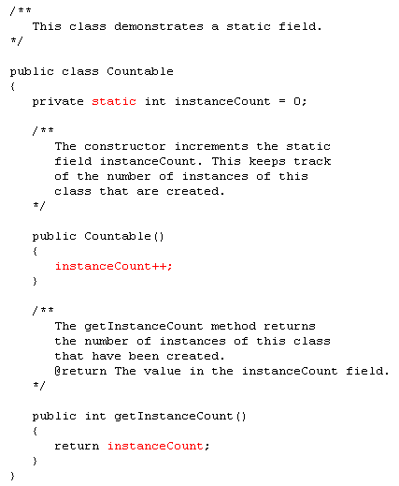
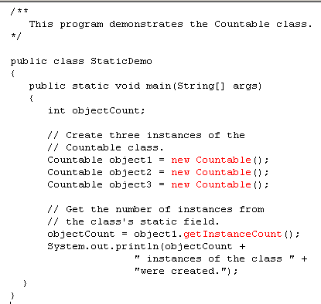
What is the output?
3 instances of the class were created

Slide 8
Static Fields
instanceCount field
(static)
3
Object1
Object2
Object3

Slide 9
Static Methods
Methods can also be declared static by placing the static keyword between the access modifier and the return type of the method.
public static double milesToKilometers(double miles)
{…}
When a class contains a static method, it is not necessary to create an instance of the class in order to use the method.
double kilosPerMile = Metric.milesToKilometers(1.0);
Examples: Metric.java, MetricDemo.java

Slide 10
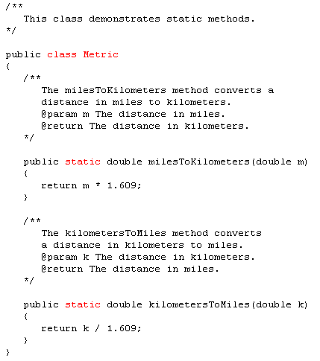
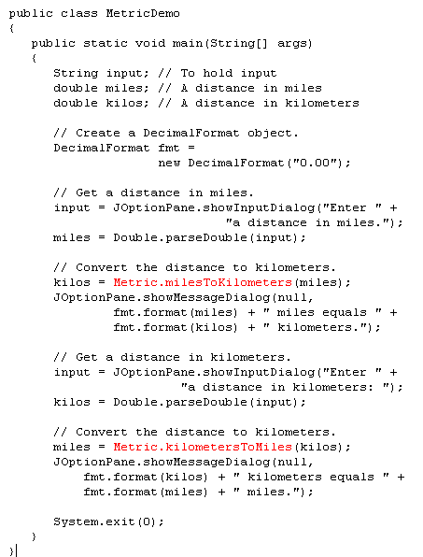

Slide 11
Static Methods
Static methods are convenient because they may be called at the class level.
They are typically used to create utility classes, such as the Math class in the Java Standard Library.
Static methods may not communicate with instance fields, only static fields.

Slide 12
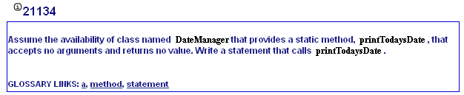
MyProgrammingLab8 – 8.1 calling static methods

Slide 13
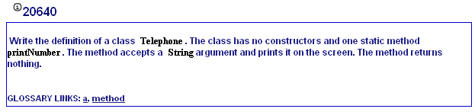
MyProgrammingLab8 – 8.1 declaring static methods

Slide 14
Passing Objects as Arguments
Objects can be passed to methods as arguments.
Java passes all arguments by value.
When an object is passed as an argument, the value of the reference variable is passed.
The value of the reference variable is an address or reference to the object in memory.
A copy of the object is not passed, just a pointer to the object.
When a method receives a reference variable as an argument, it is possible for the method to modify the contents of the object referenced by the variable.

Slide 15
Passing Objects as Arguments
Examples: PassObject2.java
A Rectangle object
length:
width:
12.0
5.0
displayRectangle(box);
Address
public static void displayRectangle(Rectangle r)
{
// Display the length and width.
System.out.println("Length: " + r.getLength() +
" Width: " + r.getWidth());
}

Slide 16
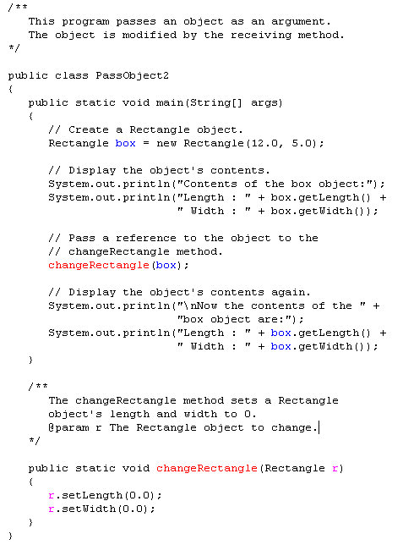
What is the output?
Length : 0.0 Width : 0.0

Slide 17
Returning Objects From Methods
Methods are not limited to returning the primitive data types.
Methods can return references to objects as well.
Just as with passing arguments, a copy of the object is not returned, only its address.
Method return type:
public static BankAccount getAccount()
{
…
return new BankAccount(balance);
}

Slide 18
Returning Objects from Methods
account = getAccount();
A BankAccount Object
balance:
3200.0
address
public static BankAccount getAccount()
{
…
return new BankAccount(balance);
}

Slide 19
The toString Method
The toString method of a class can be called explicitly:
Stock xyzCompany = new Stock ("XYZ", 9.62);
System.out.println(xyzCompany.toString());
However, the toString method does not have to be called explicitly but is called implicitly whenever you pass an object of the class to println or print.
Stock xyzCompany = new Stock ("XYZ", 9.62);
System.out.println(xyzCompany);

Slide 20
The toString method
The toString method is also called implicitly whenever you concatenate an object of the class with a string.
Stock xyzCompany = new Stock ("XYZ", 9.62);
System.out.println("The stock data is:\n" + xyzCompany);

Slide 21
The toString Method
All objects have a toString method that returns the class name and a hash of the memory address of the object.
We can override the default method with our own to print out more useful information.
Examples: Stock.java, StockDemo1.java

Slide 22
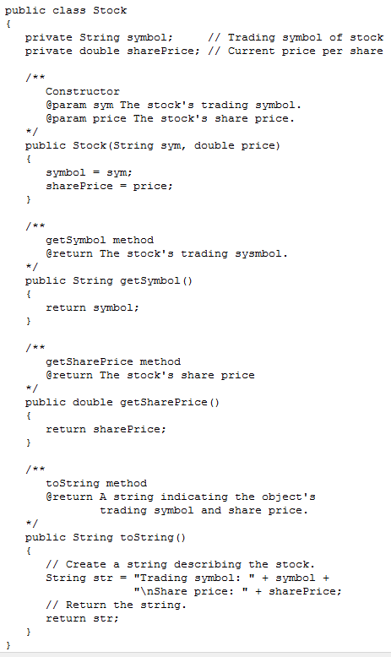
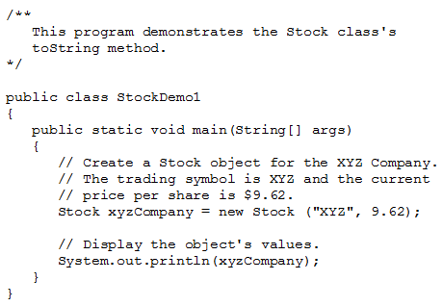
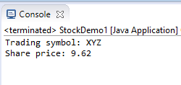

Slide 23
The equals Method
When the == operator is used with reference variables, the memory address of the objects are compared.
The contents of the objects are not compared.
All objects have an equals method.
The default operation of the equals method is to compare memory addresses of the objects (just like the == operator).

Slide 24
The equals Method
The Stock class has an equals method.
If we try the following:
Stock stock1 = new Stock("GMX", 55.3);
Stock stock2 = new Stock("GMX", 55.3);
if (stock1 == stock2) // This is a mistake.
System.out.println("The objects are the same.");
else
System.out.println("The objects are not the same.");
only the addresses of the objects are compared.

Slide 25
The equals Method
public boolean equals(Stock object2)
{
boolean status;
if(symbol.equals(object2.symbol) && sharePrice == object2.sharePrice)
status = true;
else
status = false;
return status;
}
Instead of using the == operator to compare two Stock objects, we should use the equals method.
Now, objects can be compared by their contents rather than by their memory addresses.
See example: StockCompare.java

Slide 26
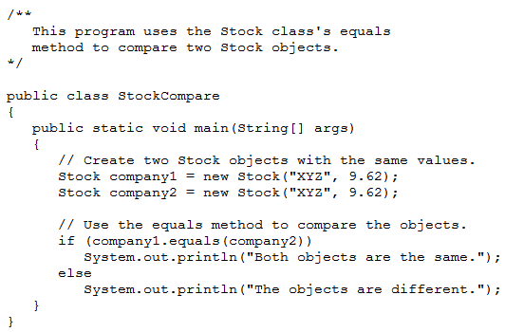


Slide 27
Methods That Copy Objects
There are two ways to copy an object.
You cannot simple use the assignment operator to copy an object
Reference only copy (shallow copy)
This is simply copying the address of an object into another reference variable.
Deep copy (correct)
This involves creating a new instance of the class and copying the values from one object into the new object.

Slide 28
Copy Constructors
A copy constructor accepts an existing object of the same class and clones it
The access modifiers work on class level, and not on object level.
That is, two objects of the same class can access each others private members.
public Stock(Stock object2)
{
symbol = object2.symbol;
sharePrice = object2.sharePrice;
}
// Create a Stock object
Stock company1 = new Stock("XYZ", 9.62);
//Create company2, a copy of company1
Stock company2 = new Stock(company1);

Slide 29
Aggregation
Creating an instance of one class as a reference in another class is called object aggregation.
Aggregation creates a “has a” relationship between objects.
Examples:
Instructor.java, Textbook.java, Course.java, CourseDemo.java

Slide 30
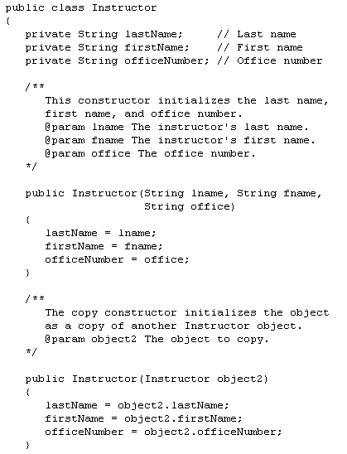
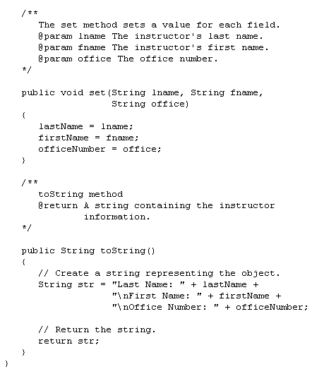

Slide 31
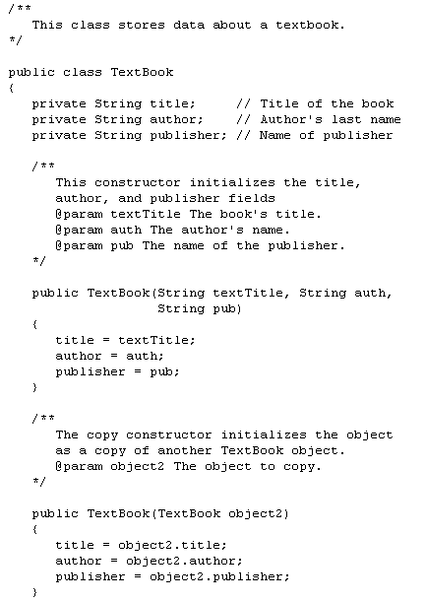
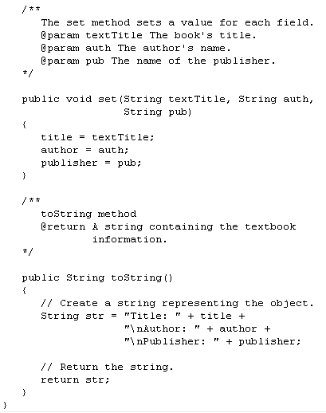

Slide 32
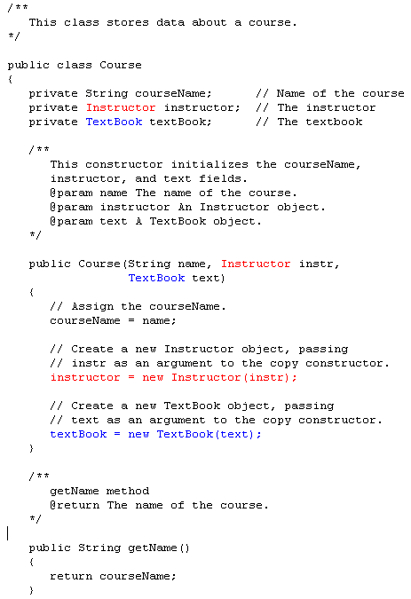
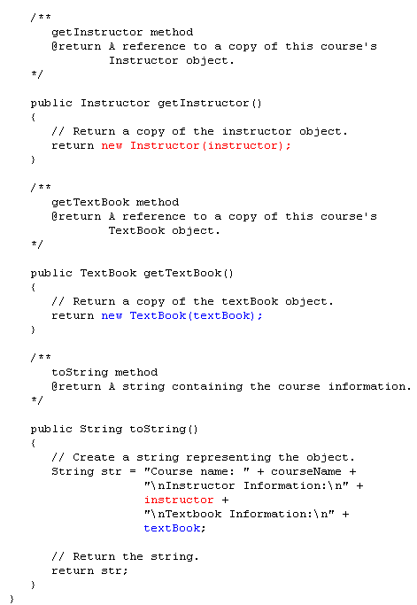
Which methods are used
here?
toString() of
Instructor and Textbook

Slide 33
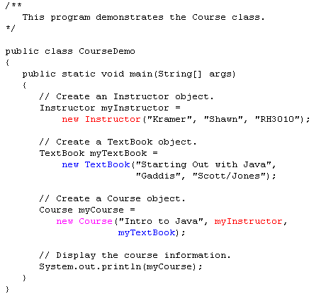

Slide 34
Aggregation in UML Diagrams
Course
- courseName : String
- Instructor : Instructor
- textBook : TextBook
+ Course(name : String, instr : Instructor, text : TextBook)
+ getName() : String
+ getInstructor() : Instructor
+ getTextBook() : TextBook
+ toString() : String
Instructor
TextBook
lastName : String
firstName : String
officeNumber : String
title : String
author : String
publisher : String
+ Instructor(lname : String, fname : String,
office : String)
+Instructor(object2 : Instructor)
+set(lname : String, fname : String,
office : String): void
+ toString() : String
+ TextBook(title : String, author : String, publisher :
String)
+ TextBook(object2 : TextBook)
+ set(title : String, author : String, publisher : String)
: void
+ toString() : String

Slide 35
Returning References to Private Fields
Avoid returning references to private data elements.
Returning references to private variables will allow any object that receives the reference to modify the variable.

Slide 36
Null References
A null reference is a reference variable that points to nothing.
If a reference is null, then no operations can be performed on it.
References can be tested to see if they point to null prior to being used.
if(name != null)
{
System.out.println("Name is: "
+ name.toUpperCase());
}
Examples: FullName.java, NameTester.java

Slide 37
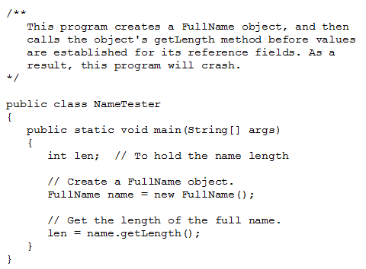

Slide 38
The this Reference
Local parameter variable feet
Shadowed instance variable
The this reference is simply a name that an object can use to refer to itself.
The this reference can be used to overcome shadowing and allow a parameter to have the same name as an instance field.
public void setFeet(int feet)
{
this.feet = feet;
//sets the this instance’s feet field
//equal to the parameter feet.
}

Slide 39
The this Reference
The this reference can be used to call a constructor from another constructor.
public Stock(String sym)
{
this(sym, 0.0);
}
This constructor would allow an instance of the Stock class to be created using only the symbol name as a parameter.
It calls the constructor that takes the symbol and the price, using sym as the symbol argument and 0 as the price argument.
Elaborate constructor chaining can be created using this technique.
If this is used in a constructor, it must be the first statement in the constructor.

Slide 40
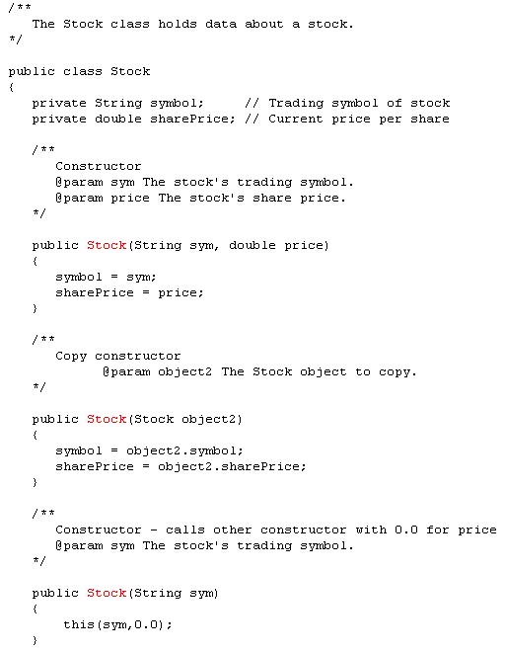

Slide 41
Enumerated Types
Known as an enum, requires declaration and definition like a class
Syntax: enum typeName { one or more enum constants }
Definition:
enum Day { SUNDAY, MONDAY, TUESDAY, WEDNESDAY, THURSDAY, FRIDAY, SATURDAY }
Declaration:
Day WorkDay; // creates a Day enum
Assignment: Day WorkDay = Day.WEDNESDAY;

Slide 42
Enumerated Types
An enum is a specialized class
Each are objects of type Day, a specialized class
Day.SUNDAY
Day workDay = Day.WEDNESDAY;
The workDay variable holds the address of the Day.WEDNESDAY object
Day.MONDAY
Day.TUESDAY
address
Day.WEDNESDAY
Day.THURSDAY
Day.FRIDAY
Day.SATURDAY

Slide 43
Enumerated Types - Methods
toString – returns name of calling constant
ordinal – returns the zero-based position of the constant in the enum. For example the ordinal for Day.THURSDAY is 4
equals – accepts an object as an argument and returns true if the argument is equal to the calling enum constant
compareTo - accepts an object as an argument and returns a negative integer if the calling constant’s ordinal < than the argument’s ordinal, a positive integer if the calling constant’s ordinal > than the argument’s ordinal and zero if the calling constant’s ordinal == the argument’s ordinal.
Examples: EnumDemo.java, CarType.java, SportsCar.java, SportsCarDemo.java

Slide 44
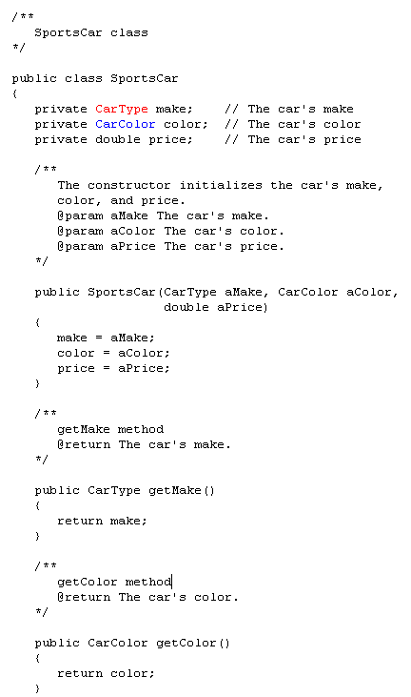



Slide 45
Enumerated Types - Switching
Java allows you to test an enum constant with a switch statement.
Example: SportsCarDemo2.java

Slide 46
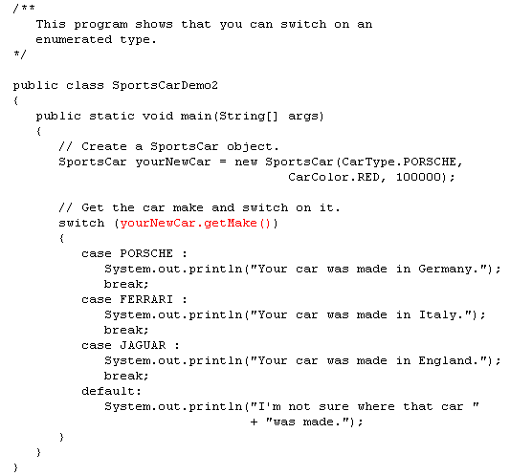

Slide 47
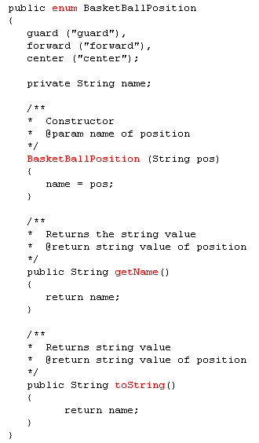
public class BasketBallPlayer {
private String firstName;
private String lastName;
private BasketBallPosition position;
. . .
}

Slide 48
Garbage Collection
When objects are no longer needed they should be destroyed.
This frees up the memory that they consumed.
Java handles all of the memory operations for you.
Simply set the reference to null and Java will reclaim the memory.

Slide 49
Garbage Collection
The Java Virtual Machine has a process that runs in the background that reclaims memory from released objects.
The garbage collector will reclaim memory from any object that no longer has a valid reference pointing to it.
BankAccount account1 = new BankAccount(500.0);
BankAccount account2 = account1;
This sets account1 and account2 to point to the same object.

Slide 50
Garbage Collection
A BankAccount object
Balance:
account1
Address
500.0
account2
Address
Here, both account1 and account2 point to the same
instance of the BankAccount class.

Slide 51
Garbage Collection
A BankAccount object
Balance:
account1
null
500.0
account2
Address
However, by running the statement: account1 = null;
only account2 will be pointing to the object.

Slide 52
Garbage Collection
A BankAccount object
Balance:
account1
null
500.0
account2
Since there are no valid references to this
object, it is now available for the garbage
collector to reclaim.
null
If we now run the statement: account2 = null;
neither account1 or account2 will be pointing to the object.

Slide 53
Garbage Collection
A BankAccount object
Balance:
account1
null
500.0
account2
The garbage collector reclaims the memory the next time it runs in the background.
null

Slide 54
The finalize Method
If a method with the signature:
public void finalize(){…}
is included in a class, it will run just prior to the garbage collector reclaiming its memory.
The garbage collector is a background thread that runs periodically.
It cannot be determined when the finalize method will actually be run.

Slide 55
Class Collaboration
Collaboration – two classes interact with each other
If an object is to collaborate with another object, it must know something about the second object’s methods and how to call them
If we design a class StockPurchase that collaborates with the Stock class (previously defined), we define it to create and manipulate a Stock object
See examples: StockPurchase.java, StockTrader.java

Slide 56
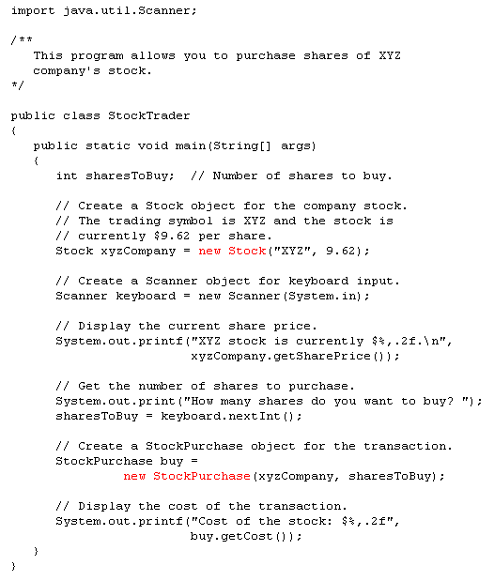
Is there a relationship
between StockPurchase
and Stock?

Slide 58
